Slide 1
DACSC TG3 (UAS Funding)
Recommendations for the Near Term

Slide 2
Background
Future success of the drone industry depends on government and private sector funding to support and facilitate the integration and operations of drones in the NAS.
The FAA requires new resources to be devoted to this task.
The FAA asked the DAC to provide near term funding recommendations by July 2017, and longer term recommendations by March 2018.
TG3 was established to provide these recommendations.

Slide 3
Assumptions and Guiding Principles
TG3 agreed to the following guiding principles:
  There will be a combination of government, industry, and shared funding across the integration efforts.
  Options for funding should not be constrained by the current traditional aviation funding structure, although in the near-term a new model may be difficult to implement.
  The recommended funding structure should not alter the current structure of funding for traditional, manned aviation.

Slide 4
Methodology
We used the analytic hierarchy process (AHP) via “Decision Lens” to rank all FAA UAS activities against a comment set of criteria.
    Safety among UAS operators, for people and property on the ground, and with current manned aviation, given a 60% weight.
    Enabling operations and technological readiness, given a 28% weight.
    Economic benefits to society and the government, given a 12% weight.
The vast majority of members participated in the rating and ranking process.

Slide 5
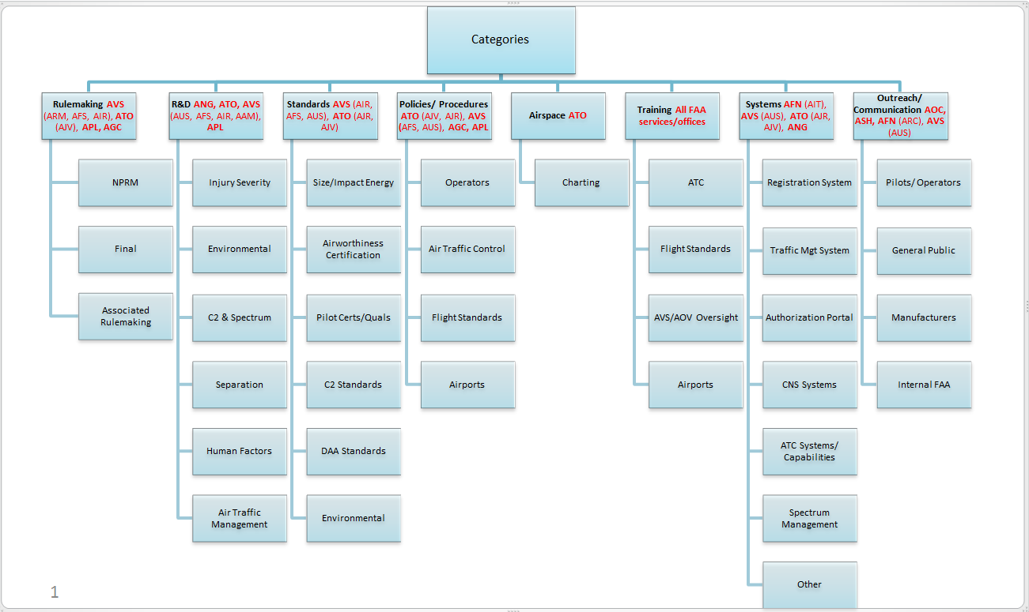
Informing our Methodology – FAA UAS Activities

Slide 6
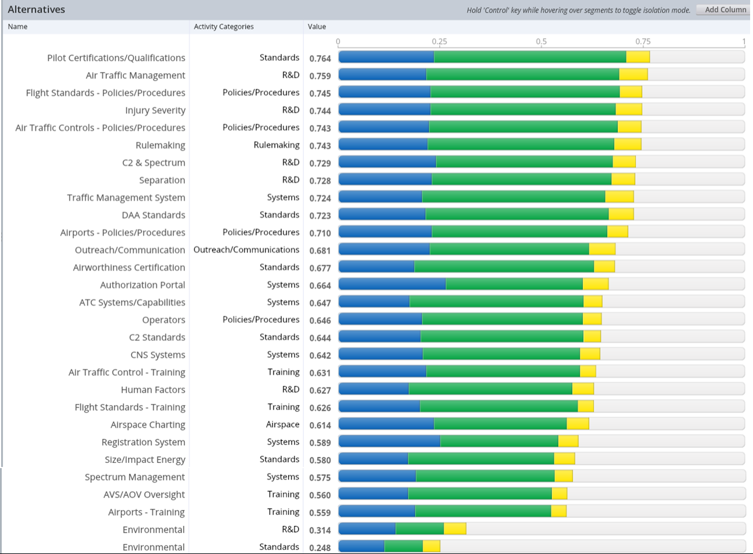
Decision Lens Results
A prioritized list of FAA activities

Slide 7
Work Flow
The group validated the results and divided into teams. Each team worked through their prioritized results to define the short-term government, industry, and collaborative efforts to fund these activities and provided written recommendations.
The reports were circulated and discussed, and consensus was reached on the recommendations.
The groups also used the recommendations from TG2 to ensure there was common guidance across all three work groups:
  Prioritization of UAS BVLOS operations within the Mode C Veil below 400 ft. AGL
  Development of technology neutral navigation performance requirements
  Evaluation of the ability of existing networks to meet low altitude UAS C2 requirements
  Establishment of a FAR Part 135 regulatory pathfinder program for commercial UAS low-altitude BVLOS operations

Slide 8
Recommendations
  All regulations, policies, and standards necessary in the next 24 months should be developed primarily by the FAA with significant industry input. We recommend that Congress appropriate additional funding and increase FAA staffing to address this ambitious work schedule.
  The research and development, and system development necessary in the next 24 months, should be shared between government and industry.
  Communications, outreach, and training necessary in the next 24 months should be shared between government and industry, depending on the activity.
  Any recommended funding structure should not alter the current structure of funding for traditional, manned aviation.
  In the future, the UAS industry may be expected to pay for the operation, maintenance, and modernization of an automated Unmanned Traffic Management (UTM) system through a yet-to-be-created “pay-for-what-you-use” funding model.

Slide 9
Regulations
Costs for these priority efforts should be primarily bourn by the FAA. These rules include:
Operations Over People (OOP)
Identification and Tracking
Section 2209 – Designation of prohibited/restricted airspace over fixed-site facilities
Counter-drone Operations and Activities
Expanded Operations (BVLOS, package delivery)
Air Carrier Certification and Operations
UAS Fee Structure

Slide 10
Policies and Standards
Costs for these priority efforts should be shared, depending on activity:
Flights Standards Policies
Air Traffic Control Policies
Operator Policies
Airports Policies
Pilot Certification and Qualification Standards
Airworthiness Certification Standards
Command and Control Standards
Detect and Avoid Standards

Slide 11
Systems and R&D
Costs for these priority efforts should be shared, depending on activity:
LAANC
  Related R&D Activity: Air Traffic Management, C2 & Spectrum, Separation
  Related Systems Activity: Traffic Management System, Authorization Portal, ATC
  Systems/Capabilities, CNS Systems, Registration System, Spectrum Management
IT Gateway
  Related R&D Activity: Air Traffic Management, Separation
  Related Systems: Traffic Management System, Authorization Portal, CNS
  Systems: Registration System
UTM
  Related R&D Activity: Air Traffic Management, C2 & Spectrum, Separation,
  Human Factors, Environmental
  Related Systems: Traffic Management System, Authorization Portal, ATC
  Systems/Capabilities, CNS Systems, Registration System, Spectrum Management

Slide 12
Outreach and Training
Costs for these priority efforts should be shared, depending on activity:
Training
  Air Traffic Control Training
  Flight Standards Training
  Airports Training
  AVS/AOV Oversight Training
Outreach and Communication

Slide 13
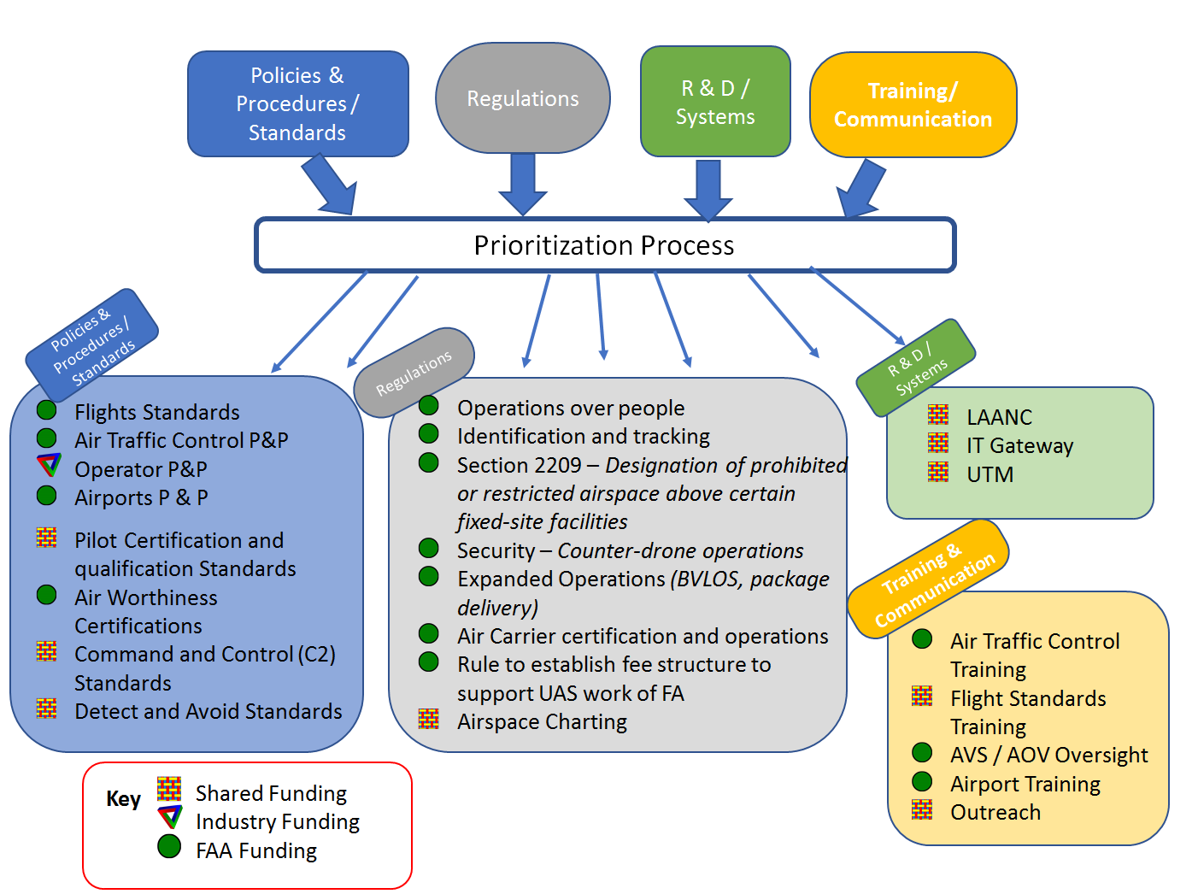

Slide 14
Activity and Funding List
Priority | Activity | Lead Funding
1 | Pilot Certifications/Qualifications | Gov’t. & Ind.
2 | Air Traffic Management – R&D | Gov’t. & Ind.
3 | Flight Standards Policies/Procedures | Government
4 | Air Traffic Controls - Policies/Procedures | Government
5 | Injury Severity – R&D | Govt. & Ind.
6 | Rulemaking | Government
7 | C2 & Spectrum – R&D | Gov’t. & Ind.
8 | Separation | Gov’t. & Ind.
9 | DAA Standards | Gov’t. & Ind.
10 | Traffic Management System | Gov’t. & Ind.
11 | Airports - Policies/Procedures | Government
12 | Outreach/Communication | Gov’t. & Ind.
13 | Airworthiness Certification | Gov’t. & Ind.
14 | Authorization Portal | Gov’t. & Ind.
15 | Operators | Government
16 | ATC Systems/Capabilities | Gov’t. & Ind.
17 | C2 Standards - Standards | Gov’t. & Ind.
18 | CNS Systems | Gov’t. & Ind.
19 | Air Traffic Control - Training | Gov’t. & Ind.
20 | Flight Standards - Training | Gov’t. & Ind.
21 | Human Factors – R&D | Gov’t. & Ind.
22 | Airspace Charting | Government
23 | Registration System | Government
24 | Size/Impact Energy | Government
25 | Spectrum Management | Government
26 | AVS/AOV Oversight | Government
27 | Airports - Training | Government
28 | Environmental – R&D | Gov’t. & Ind.
29 | Environmental - Standards | Government

Slide 15
FAA Reauthorization and Appropriations
  FY17 FAA UAS Budget: +$20M for ATO, +$10M for AVS, and +$2.67M for R&D (based on the FY17 President’s Budget request).
  Authority for these funds runs through FY18.
  Significant portions of the House and Senate’s FAA Reauthorization bills are dedicated to UAS. Many of the provisions come with new rulemaking and reporting requirements, which will strain already limited FAA budgetary resources.

Slide 16
What’s Next for TG3?
The long term questions are more complicated.
  Cost accounting measures?
TG3 will consider options and identify self-sustaining and scalable funding sources that allow all users of the NAS to fund the necessary resources to ensure its safe and efficient operation.
TG3 will work to identify a funding option for the UAS industry that is segregated from the system that funds manned aviation.
The funding mechanism should be flexible enough to support potential far-reaching structural changes to FAA funding and activities.
TG3 will consider new sources of funding for the long term, including user fees or similar pay-for-what-you-use services.

Slide 17
Listening Session
TG3 had a listening session on long-term issues on July 14th.
It was open to the entire DAC SC, for as many options and voices to heard.
What we heard.

Slide 18
Questions?

Slide 19





Informing our Workflow – FAA UAS Integration
2016 2017 2018 2019 2020
. . . . . .
2025
Registration & Part 107
Security & UAS Over People
Expanded Operations
Integrated Operations Small Cargo Operations
Capital Investments & Automation
Segregation
LAANC Pre-
Implementation
LAANC Implementation /
UTM Pre-Implementation
UTM Implementation
(full data exchange)
$$
Ongoing Maintenance – $$
Registration, Waiver Portal
Integrated Gateway & Data Warehouse Development
Integrated Gateway Sustainment
$
+ Additional Modules
Medium / Large UAS Integration Pre-Implementation (R&D)
Medium / Large UAS Integration Implementation
Integration
$$
ATM Updates – ERAM, STARS, NAS Voice Switch Development of Minimum Performance Standards
Policy, Coordination, & Operations
ATO, AVS
Manual Processing of Authorizations
(e.g. waivers, airspace authorizations, COAs)
$
All FAA
Program and Activity Support
$
(e.g. rulemaking, safety standards, policy development, enforcement, security, outreach, etc.)

Slide 20
Informing our Workflow – FAA Definitions
Policies and Procedures: Procedures that must be developed for air traffic control facilities, such as ARTCCs and other Air Traffic Management personnel, UAS operators, manufacturers, and other airspace users, to enable the operational milestones. Specific policies/procedures to be developed or updated include: Flight Standards, Air Traffic Controls, Operator Policies, Airport Policies, and Airspace Charting.
Rulemaking: Key rulemaking activities needed to enable the milestone, as well as any relevant public law changes associated with the milestone that may be needed or expected.
Standards: Standards needed to guide technical and operational aspects of the operational milestone; e.g., detect and avoid, pilot certification, aircraft and control station certification standards. Specific examples include: Pilot Certifications/Qualifications, DAA Standards, C2 Standards and Environmental Standards.
Outreach/Communication: Any major outreach and communications efforts with the public, UAS stakeholders, other airspace users, Tribal Governments, or oversight organizations such as Congress, required to support safe implementation of the operational milestone, including a process to address concerns that may come up from communities, interest groups and individuals as UAS are integrated into the NAS
Training: Any training of the FAA workforce that will be needed to enable the UAS activity. Specific examples of training include: Air Traffic Control Training, Flight Standards Training, AVS/AOV Oversight training and Airports Training.
R&D: All R&D activities needed to determine solutions to unresolved or potential issues associated with that operational milestone; e.g., supporting performance-based requirements or safety analyses for Detect and Avoid (DAA). Specific R&D examples include: Air Traffic Management, Injury Severity, C2 and Spectrum, Separation, Human Factors, and Environmental Research.
Systems: Any infrastructure development or modification needed to enable the operational milestone; e.g., ATC systems, communications, navigation, and surveillance (CNS) infrastructure, and UAS operator support systems such as the registration system. Specific examples of FAA Systems include: Traffic Management System, Authorization Portal, ATC Systems/Capabilities, CNS Systems, Registration System, and Spectrum Management.

