Slide 1
DACSC TG1 Status Update Co-Chairs : Dr. John Eagerton, Brendan Schulman

Slide 2
Task Group 1 Tasking Statement (Reminder)
The (big, audacious, transformative) TASK:
Develop a set of consensus based recommendations :
the roles and responsibilities of federal, state, and local governments in regulating and enforcing drone laws
Consider and include recommendations regarding:
Defining low-altitude UAS navigable airspace susceptible to State/local governmental interests;
Relative roles and responsibilities of the Federal, State and local governments;
Enforcement;
Education;
Technological tools and solutions;
Local government operational issues

Slide 3
Progress Report
Incorporated guidance from last DAC meeting
Focus more on Roles & Responsibilities task item
RTCA Added new member and observer participants (local/state government)
Three days of in-person TG meetings (May 25, July 10-11) and a conference call (June 14)
Extensive discussion on governing models based on altitude

Slide 4
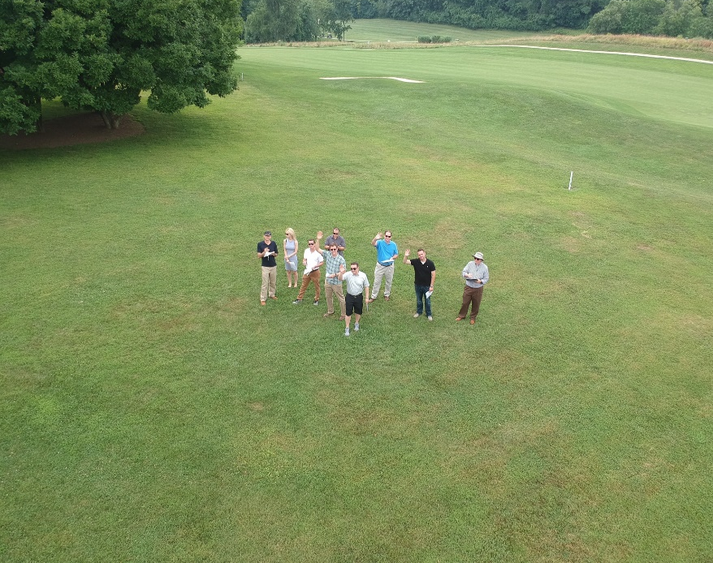
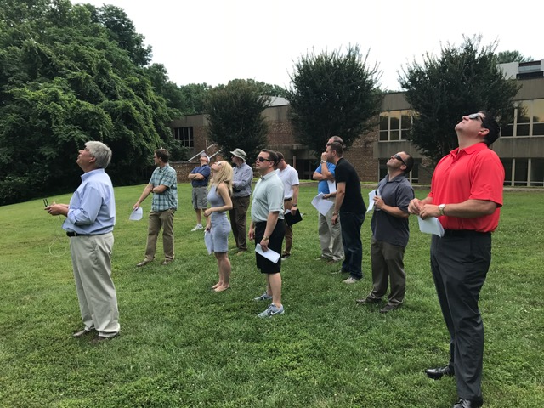
Progress Report
“Matrix” of existing roles and responsibilities
Fact gathering from two additional law enforcement SMEs
Altitude observations “field trip”

Slide 5
Progress Report
TG1 continues to work towards developing consensus recommendations
Timeline: Will proceed with urgency, and work to deliver initial recommendations by November (the next DAC meeting), with further guidance from FAA and DAC as to what is most useful

